Slide 1
Row & Column Dominance

Slide 2
<rowdic>
 | Minterm
Pi

Slide 3
PI & EPI
rowdic (Dictionary)
{‘2201’: [5, 13], ‘0022’: [0, 1, 2, 3], ‘0202’: [0,1,4,5]… }
PI (String)
Minterm (List)

Slide 4
<coldic>
 | Minterm
Pi

Slide 5
PI & EPI
coldic (Dictionary)
{‘0’: [‘0022’, ‘0202’, ‘0220], ‘1’: [‘0022’, ‘0202’]… }
Minterm (Int)
PI (String-List)

Slide 6
Column Dominance

Slide 7
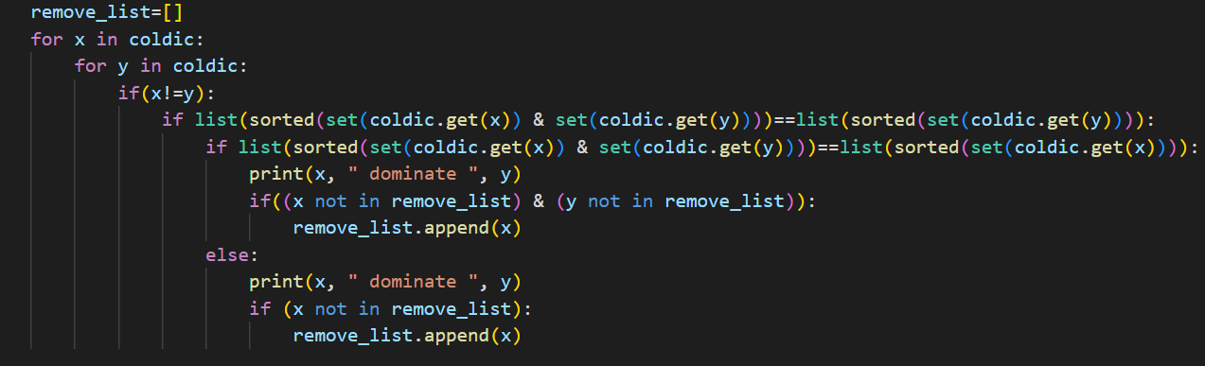
Column Dominance
 | Minterm
PI |  | ∨
 |  | ∨ | ∨

Slide 8
Column Dominance
 | Minterm
PI |  | ∨
 |  | ∨ | ∨

Slide 9
Column Dominance
 | Minterm
PI |  | ∨
 |  | ∨ | ∨

Slide 10
Column Dominance
 | Minterm
PI |  | ∨
 |  | ∨ | ∨

Slide 11
Column Dominance
 | Minterm
PI |  | ∨
 |  | ∨ | ∨

Slide 12
Column Dominance
 | Minterm
PI |  | ∨
 |  | ∨ | ∨

Slide 13
Column Dominance
 | Minterm
PI |  | ∨
 |  | ∨ | ∨
X Y

Slide 14
Column Dominance
 | Minterm
PI |  | ∨
 |  | ∨ | ∨
X Y

Slide 15
Column Dominance
 | Minterm
PI |  | ∨
 |  | ∨ | ∨
지배
피지배

Slide 16
Column Dominance
 | Minterm
PI |  | ∨ | ∨
 |  | ∨ | ∨
지배
피지배

Slide 17
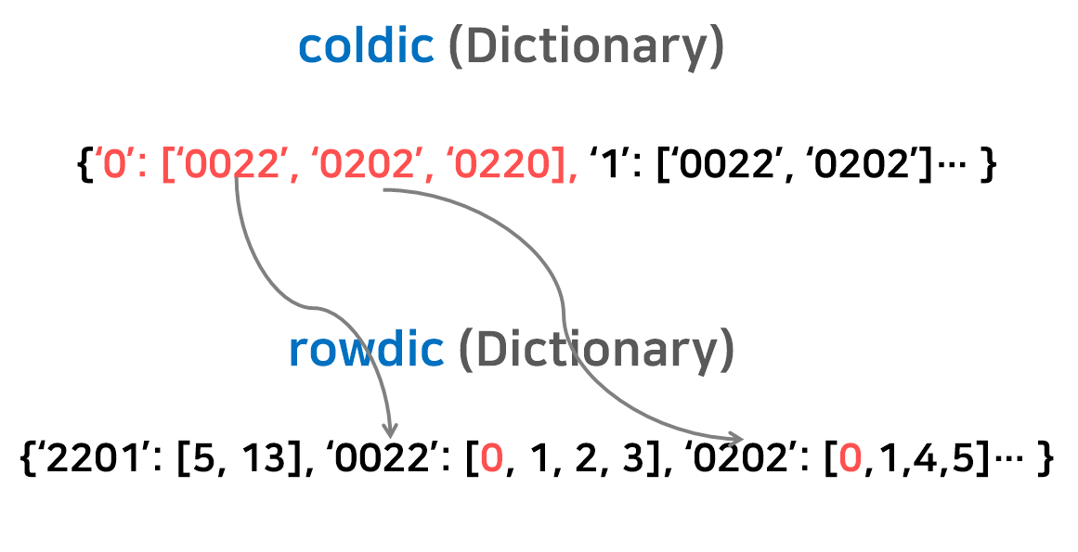
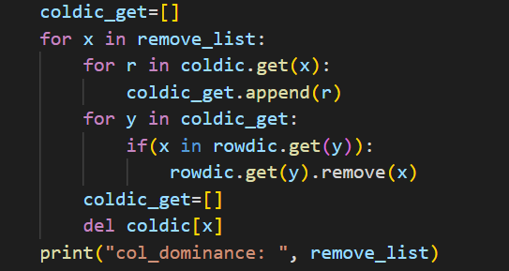
Column Dominance

Slide 18
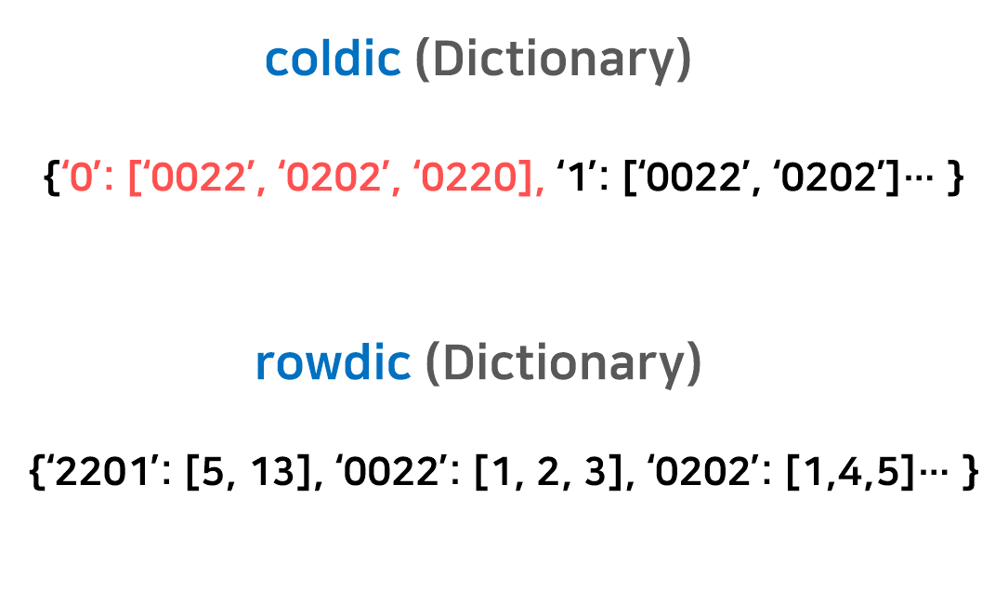
Column Dominance

Slide 19
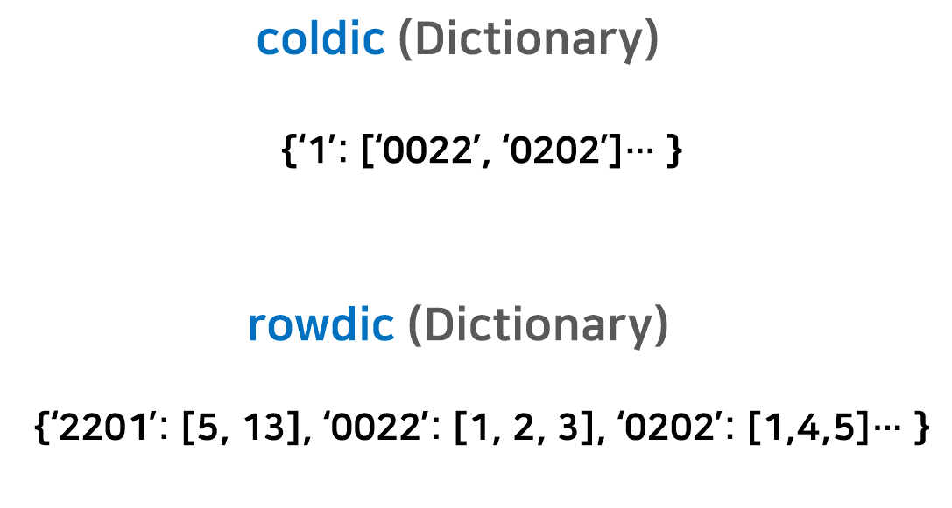
Column Dominance

Slide 20
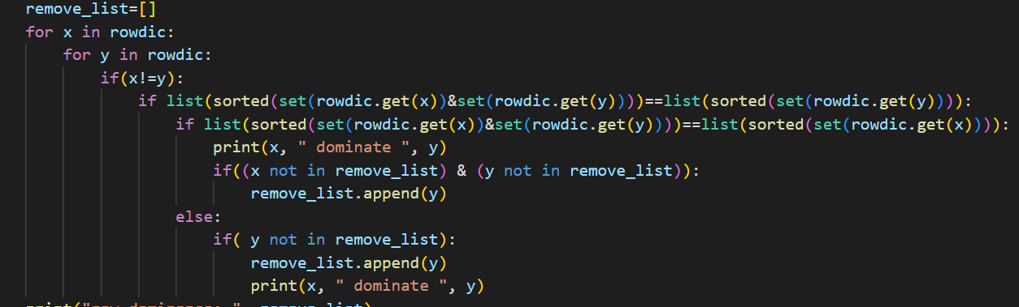
Row Dominance
 |  |  | ∨
 |  | ∨ | ∨

Slide 21
Row Dominance
 |  |  | ∨
 |  | ∨ | ∨

Slide 22
Row Dominance
 |  |  | ∨
 |  | ∨ | ∨

Slide 23
Row Dominance
 |  |  | ∨
 |  | ∨ | ∨

Slide 24
Row Dominance
 |  |  | ∨
 |  | ∨ | ∨
피지배
지배

Slide 25
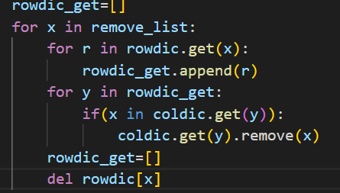
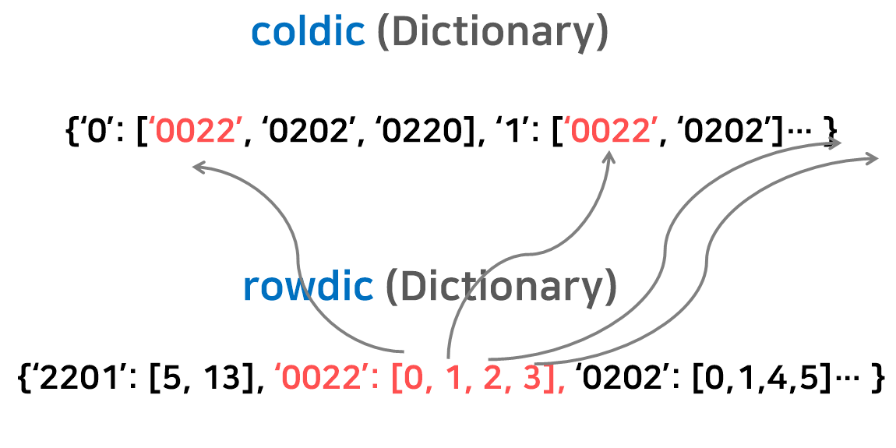
Row Dominance

Slide 26
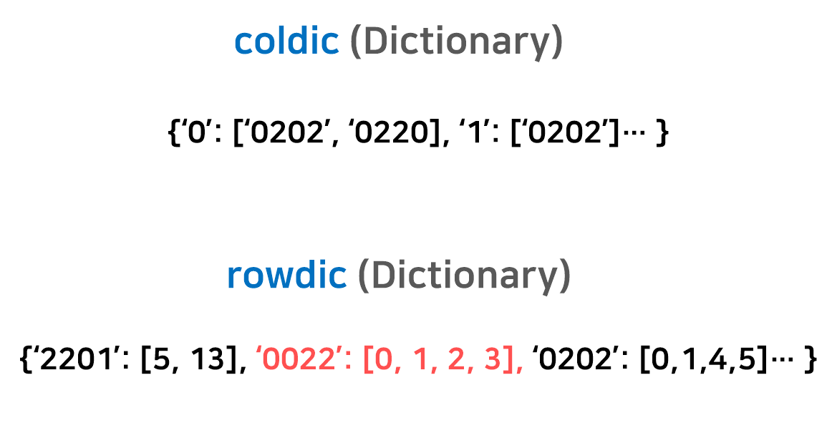
Row Dominance raw

Slide 27
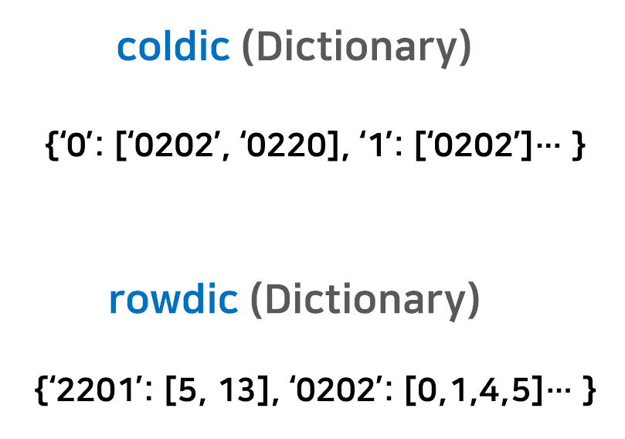
Row Dominance

Slide 28
QM Method
Find all PIs to construct a PI table
Find EPIs to simplify the table
If ( no NEPI remained) -> then quit
3. Apply column dominance raw
4. Apply row dominance raw
If ( any simplification made)

Slide 29
Run!
minterm=[4,11,0,1,2,3,4,5,6,10,11,13,14]
 | 0 | 1 | 2 | 3 | 4 | 5 | 6 | 10 | 11 | 13 | 14
0022 | ∨ | ∨ | ∨ | ∨
0202 | ∨ | ∨ |  |  | ∨ | ∨
0220 | ∨ |  | ∨ |  | ∨ |  | ∨
2012 |  |  | ∨ | ∨ |  |  |  | ∨ | ∨
2201 |  |  |  |  |  | ∨ |  |  |  | ∨
2210 |  |  | ∨ |  |  |  | ∨ | ∨ |  |  | ∨

Slide 30
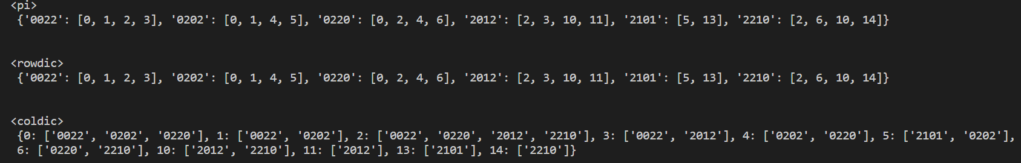
Run!

Slide 31
EPI
epi_list=[’2012’, ‘2101’, ‘2210’]
 | 0 | 1 | 2 | 3 | 4 | 5 | 6 | 10 | 11 | 13 | 14
0022 | ∨ | ∨ | ∨ | ∨
0202 | ∨ | ∨ |  |  | ∨ | ∨
0220 | ∨ |  | ∨ |  | ∨ |  | ∨
2012 |  |  | ∨ | ∨ |  |  |  | ∨ | ∨
2101 |  |  |  |  |  | ∨ |  |  |  | ∨
2210 |  |  | ∨ |  |  |  | ∨ | ∨ |  |  | ∨

Slide 32
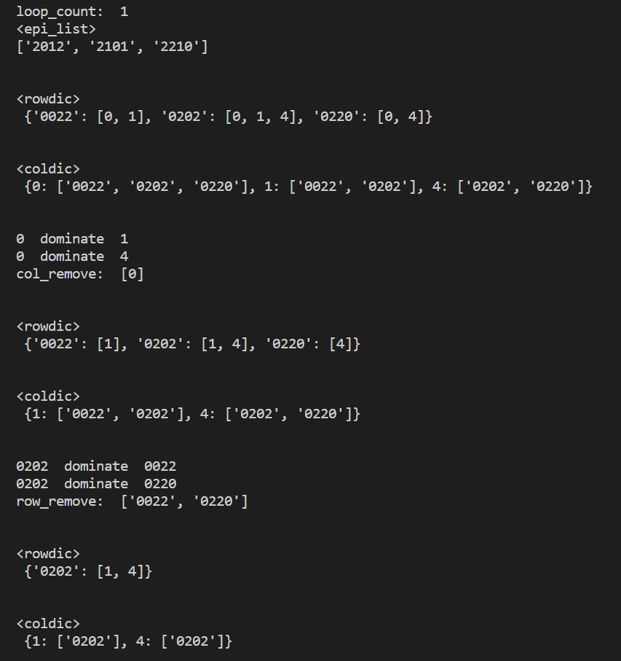
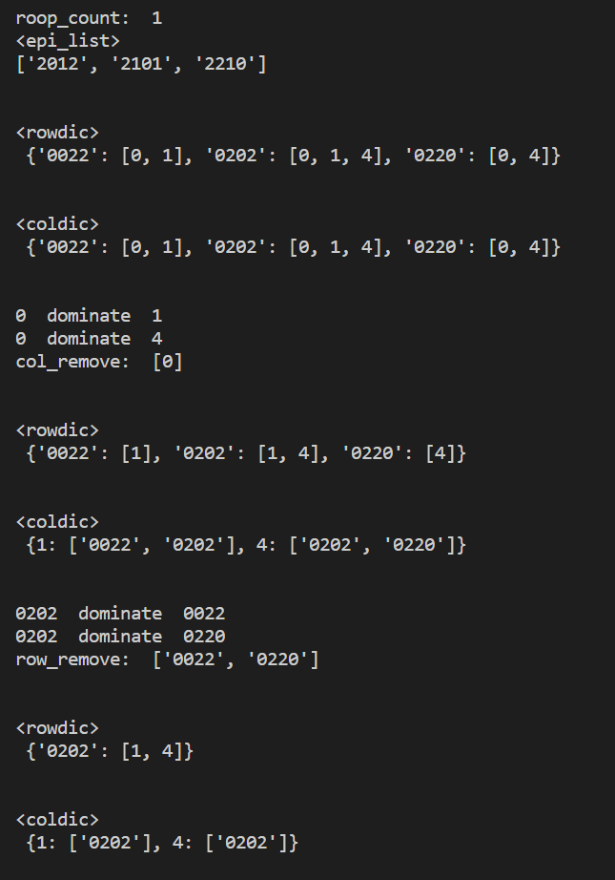
EPI
첫 번째 순환
NEPI (o)
rowdic={’0022’: [0, 1], ‘0202’: [0, 1, 4], ‘0220’: [0, 4]}
coldic={0: [’0022’, ‘0202’, ‘0220’], 1: [’0022’, ‘0202’],
4: [’0202’, ‘0220’]}
 | 0 | 1 | 4
0022 | ∨ | ∨
0202 | ∨ | ∨ | ∨
0220 | ∨ |  | ∨

Slide 33
Column Dominance
첫 번째 순환
0 dominance 1
0 dominance 4
col_remove : [0]
 | 0 | 1 | 4
0022 | ∨ | ∨
0202 | ∨ | ∨ | ∨
0220 | ∨ |  | ∨

Slide 34
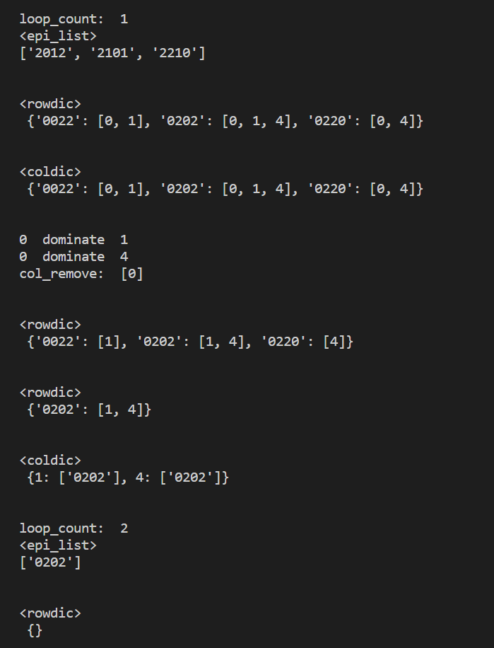
Column Dominance
첫 번째 순환
rowdic={’0022’: [1], ‘0202’: [1, 4], ‘0220’: [4]}
coldic={1: [’0022’, ‘0202’], 4: [’0202’, ‘0220’]}
 | 1 | 4
0022 | ∨
0202 | ∨ | ∨
0220 |  | ∨

Slide 35
RowDominance
첫 번째 순환
0202 dominance 0022
0202 dominance 0220
col_remove : [’0022’, ‘0220’]
 | 1 | 4
0022 | ∨
0202 | ∨ | ∨
0220 |  | ∨

Slide 36
RowDominance
첫 번째 순환
rowdic={‘0202’: [1, 4]}
coldic={1: [‘0202’], 4: [’0202’]}
 | 1 | 4
0202 | ∨ | ∨

Slide 37
EPI
Column Dominance raw
첫 번째 순환
Row
Dominance raw
Simplification (o)

Slide 38
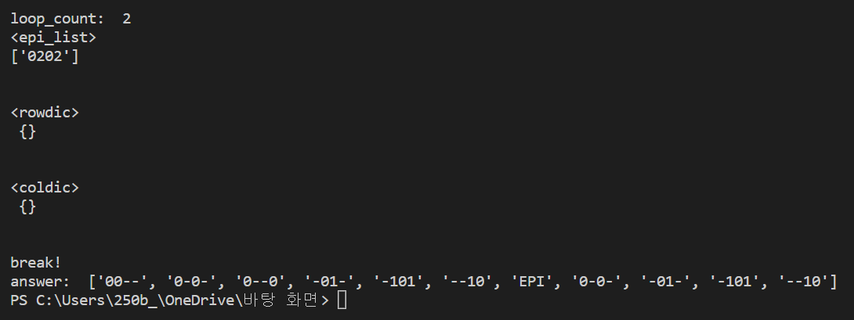
EPI
epi_list=[’0202’]
 | 1 | 4
0202 | ∨ | ∨

Slide 39
EPI
rowdic={}
NEPI (X)
coldic={}

Slide 40
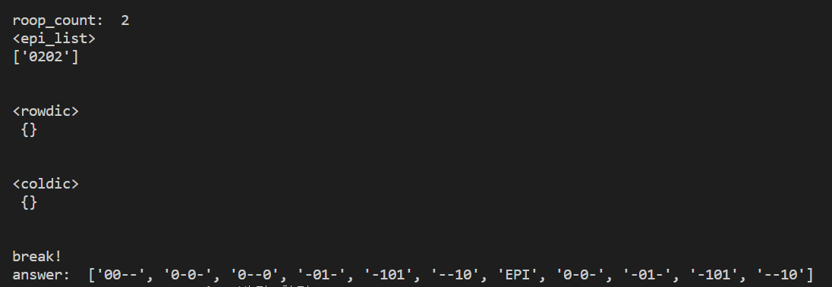
Done!
EPI
두 번째 순환
NEPI (X)
break
최종 결과

